Slide 2

UK Price Paid and Energy Performance Study
Data Warehousing and Design Techniques
Group: Thanh Tran (000285359)
Nghia Nguyen (000275466)
Mohsin Qureshi (000341950)
Notes:
Hello, welcome to our project demonstration!
We will be discussing about the practical implementation of the technical solution in addition to the design for a system that we have been working for a study in real estate valuation model enriched with energy performance.
So let’s get started!

Slide 3
Introduction
Conception of data warehousing and ETL service implementing OLTP and OLAP processes
Business problem: UK real estates valuation and property energy performance
Objectives:
Technical setup for automatic data flow
Answers to 3 strategic questions:
Real estate valuation and market trends
Energy performance of properties
Correlation of valuation and energy performance of properties
Notes:
Our project focuses on defining a conception of data warehousing and designing an ETL (Extract-Transform-Load) service to practice the OLTP and OLAP processes on a business problem in the area of UK real estate’s valuation in a consideration of energy impacts of the properties using open data provided by the UK government.
The objectives of the project are a well-designed data warehouse that is organized and highly facilitates the operations and maintenance, and an ETL solution that can be reused at anytime to automatically update data, or they can be set as a cron job to schedule the execution of data update without manual work.
Linnks to implemented code base and full resultant data set has been provided in the report
Some useful insights can also be derived with business intelligence solution in order to resolve three strategic business questionsconcerning:
Real estate valuation and market trends
Energy performance of properties
Correlation between real estates’ value and market behaviours and the energy performance

Slide 4
Data sources
UK price paid (PPD)
Information on all property sales
Department for Levelling Up, Housing and Communities (DLUHC) of UK
https://www.gov.uk/government/statistical-data-sets/price-paid-data-downloads
Energy performance certificate (EPC)
Department for Levelling Up, Housing and Communities (DLUHC) of UK
https://epc.opendatacommunities.org/
Unique property reference number (UPRN)
geometries in British National Grid and Latitude and Longitude
https://osdatahub.os.uk/downloads/open/OpenUPRN
Notes:
Three official data sources and archives have been used for this project.
UK price paid
This data is a land registration data provided by the department for housing and communities with the coverage of UK and Wales. The data source provides information on all property sales in England and Wales that have either been sold for value or lodged for registration. The data is updated on the 20th working day of each month. The data can be accessed from the following link:
https://www.gov.uk/government/statistical-data-sets/price-paid-data-downloads
Energy performance certificate
This data source provides access to all energy performance certificates (EPCs) for building register in England and Wales. The data source is maintained by the department for Levelling Up, Housing and Communities (DLUHC) of UK. The data can be accessed from the following link:
https://epc.opendatacommunities.org/
Unique property_reference_number
This open data hub contains a frequently updated data on unique property reference numbers enriched with respective geometries in British National Grid and Latitude and Longitude. This data provides the opportunity to enrich the data visualization with map view or linking data to any further data set if the project has a chance to expand. The data can be accessed from the following link:
https://osdatahub.os.uk/downloads/open/OpenUPRN

Slide 5
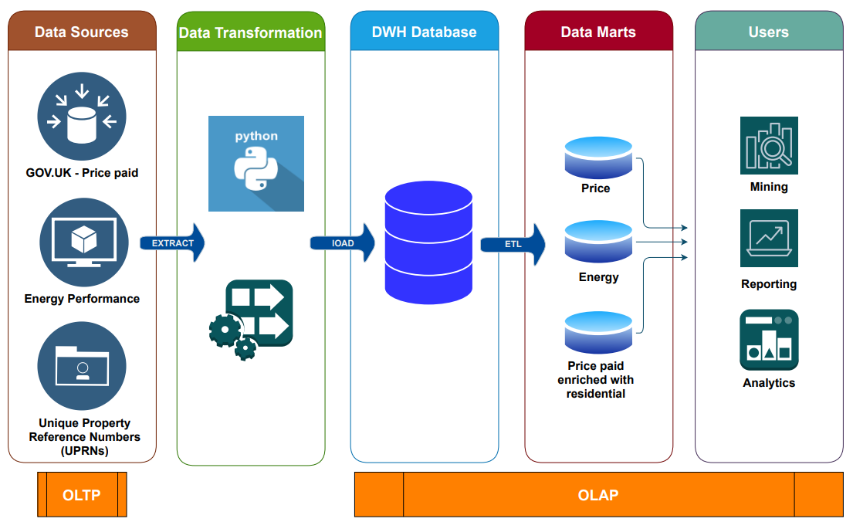

OLTP & OLAP
Notes:
In this case, The process began by obtaining datasets containing information related to real estate, including price paid, energy performance, and unique property reference numbers. These datasets were retrieved from relevant data sources and then processed and transformed into a usable format using Python programming language and SQL.
Once the data was transformed, it was loaded into a centralized database, which facilitated the creation of different data marts. The data marts were created based on specific business strategies and analysis requirements of stakeholders. The partitioning of data into different data marts enabled the analysis of different aspects related to the real estate market.
One of the main analyses conducted using the data marts was related to real estate value. The data marts were utilized to examine the value of different types of properties based on factors such as property type, category, county, and mechanical ventilation. This analysis provided valuable insights into the real estate market, which can be used by various stakeholders, including buyers, sellers, and real estate agents.
Another analysis conducted using the data marts was related to energy performance trends. The data marts were used to analyze the energy performance trends of different types of properties. This analysis provided insights into the energy efficiency of different types of properties and helped identify areas for improvement.
The data marts were also utilized to investigate the correlation between real estate value and energy performance. This analysis helped to identify the relationship between energy efficiency and property values and can help identify opportunities for improving energy efficiency in the real estate market.

Slide 6



Data warehousing & ETL service
SOURCE
Source code: https://github.com/DarvinciVincent/BI_UK_realestates_pricepaid_energyperformance
PricePaid
(GOV.UK)
EPC (Opendatacommunities)
UPRN
(OS datahub)
DATABASE
RAW
price_paid
residential_building_epc_certificate
unique_property_reference_number
TRANSFORMED
pricepaid_to_residential_epc
pricepaid_enriched_with_residential_epc
ANALYTICS
BI_project_part_A
Notes:
We provide solution for the ETL service in the source code which was made public and can be accessed via the link shown on the slide.
So here is the demonstration of the ETL service implemented for this project.
To design the solution for data warehousing and ETL service, we considered the data warehouse as having three data layers namely raw, transformed and analytics and data updating can be conducted automatically as data flow from an input to an output through a system of pipelines.
For each data source, we can have an extractor to extract the data and load it to the raw layer or section of the data warehouse. Then, any further transformation can be done to alter or enrich data according to specific needs. The transformed data can then be stored in the transformed layer. Finally, upon requests, the data can then further be filtered and ordered, and then finally loaded to the analytics layer or in the other words, a data mart, to be ready for delivery or as backend interface of other services or applications.

Slide 7
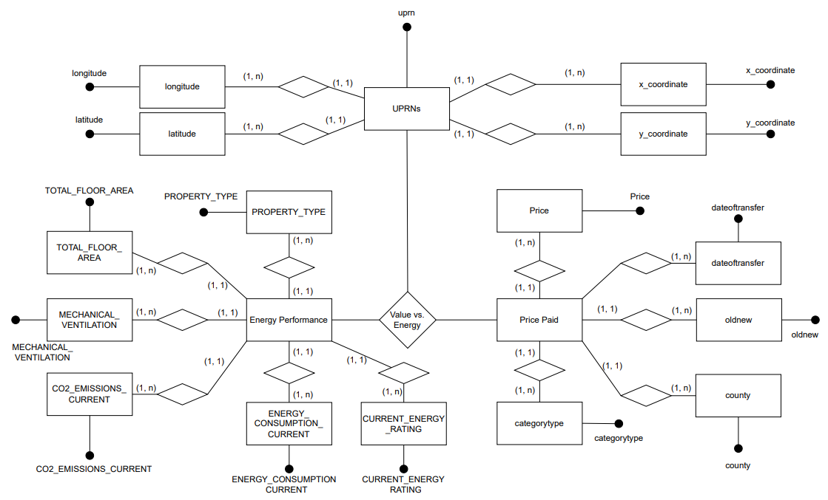
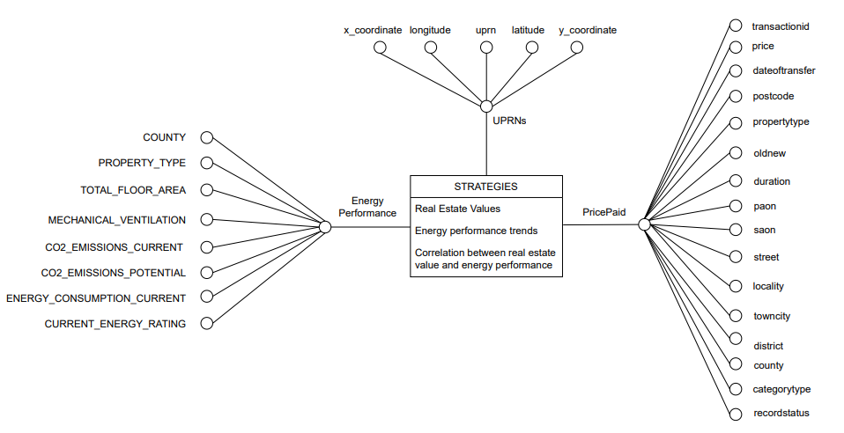
DFM & ER Model
Notes:
So here on the left side, we are showing the fact model, and from the right side, we are showing the ER model of the project topic.
So from the fact model, it is clear that the objective of the project is to gain insights from the 3 strategic questions and we are building technical solution around that. To briefly explain that, we need 3 datasets which are the pricepaid data, the energy performance data and the unique property reference number data. We also listed the useful features that we are using in our modelling from each of the dataset.
The same idea can also be concluded from the ER model, but with the ER model, you will be supplied with more information such as the relationship of entities, it is either 1-1 or 1-m.
So from the model, it is now clear of a structure of how we are defining our problem and how we gonna design it optimally to support the business intelligence part and any other part that is needed.

Slide 8
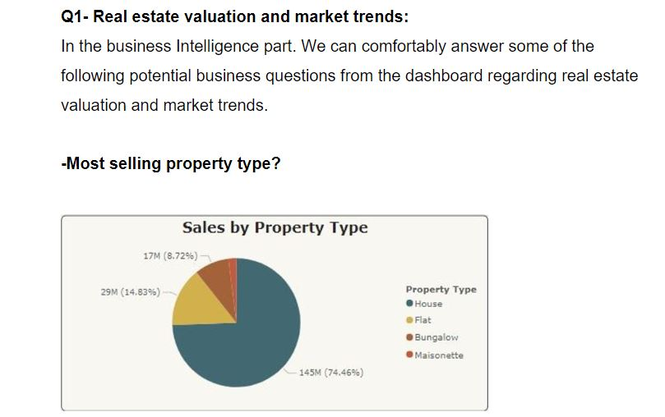
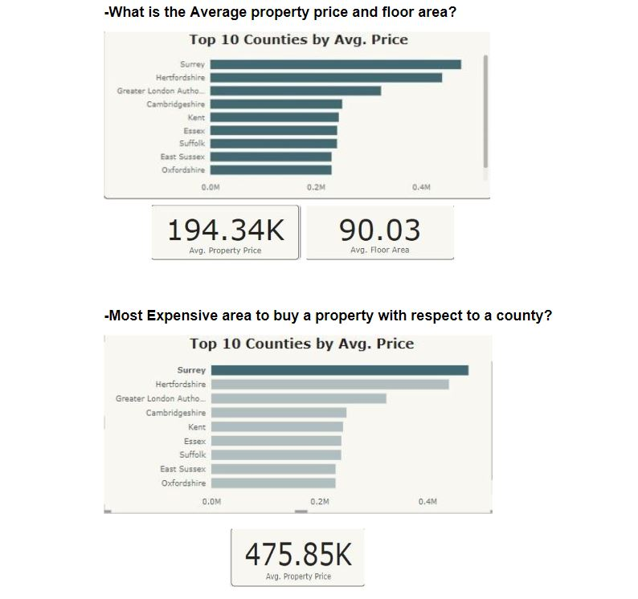
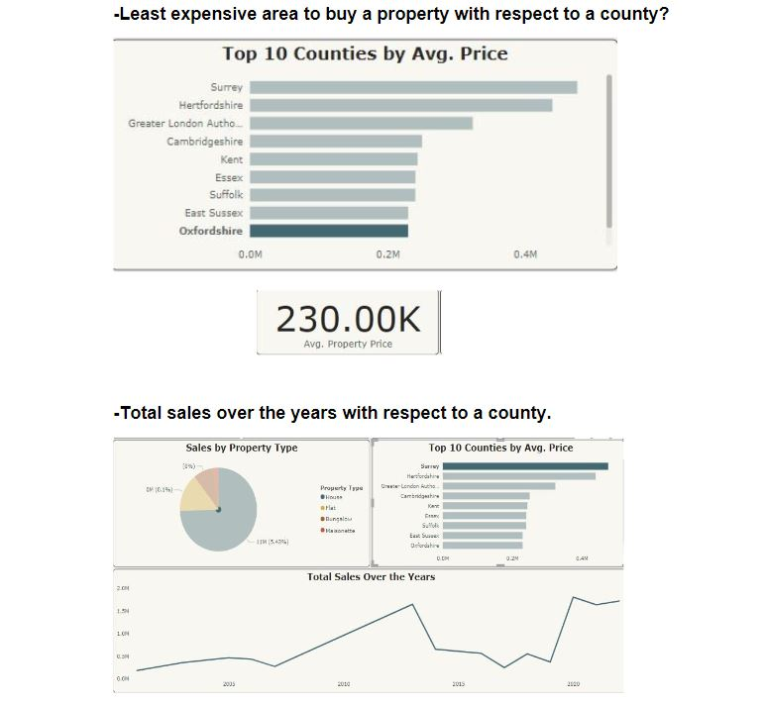

Business Intelligence
Real estate valuation and market trends:

Slide 9
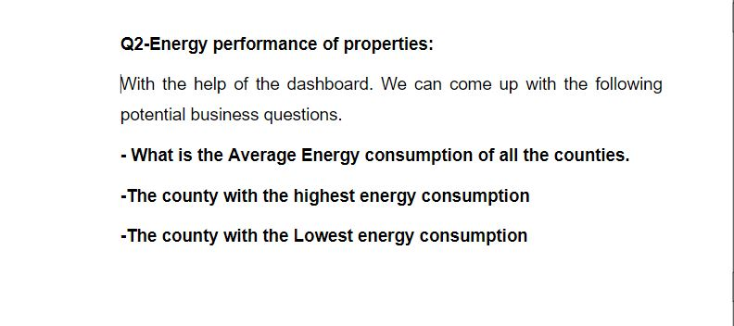
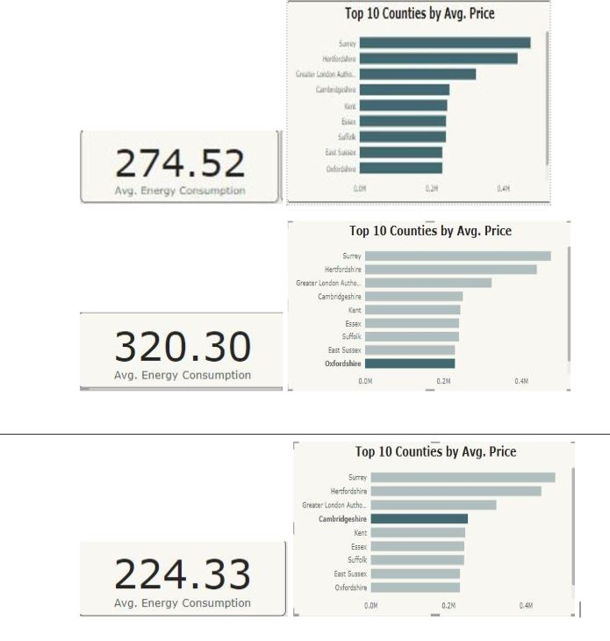
Business Intelligence
Energy performance of properties:

Slide 10
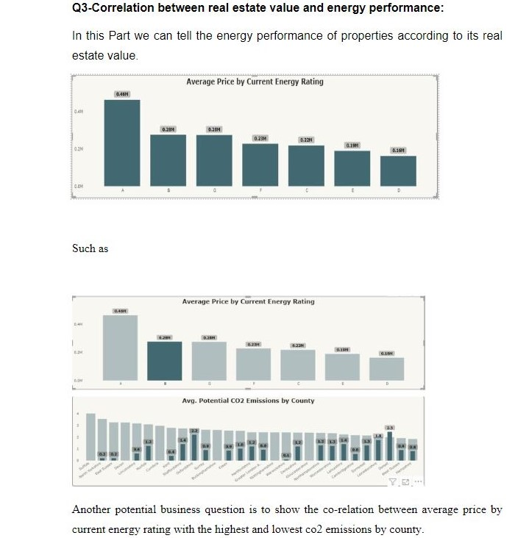
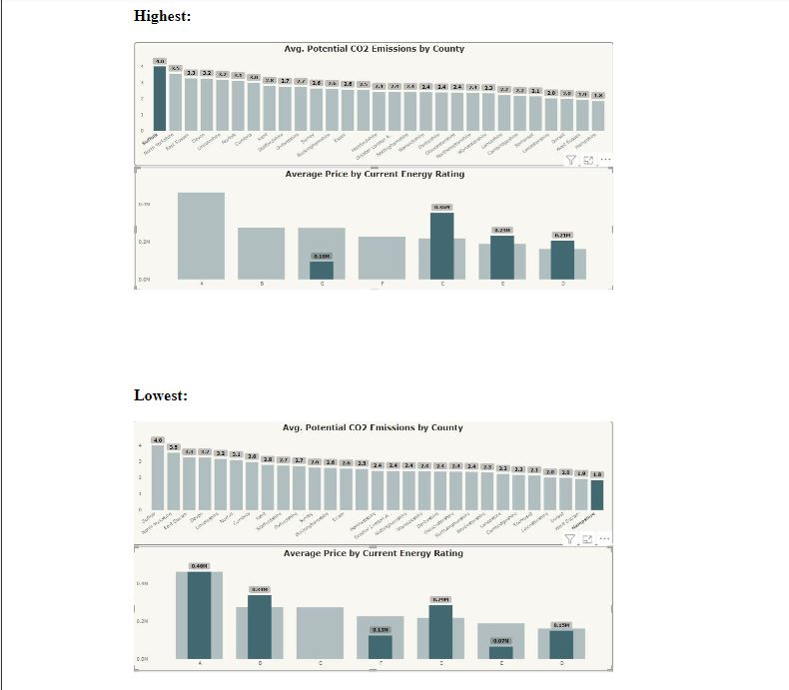
Business Intelligence
Correlation between real estate value and energy performance:

Slide 11
Thank you

